Slide 1

Game Programming, KFUPM
SWE 402, Lecture 5
Programming Best Practices
Dr. Omar Hammad, KFUPM

Slide 2

A simple mario Jump
Notes:
Best practices are not about being fancy. They’re about making change cheap. Games change constantly.

Slide 3
Your code should be ..
Easy to read
Fault-tolerant
Naming, Small Functions..
Private, Defensive Checks..
Efficient
Designer-friendly
Loop, Caching, Algorithms..
Expose variables, Attributes..

Slide 4
Easy to read?
Notes:
what does easy to read mean?

Slide 5
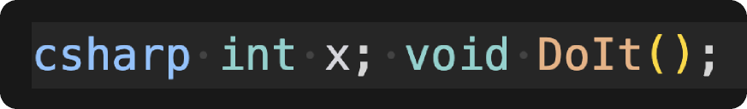
Easy to read > Naming
Notes:
would you prefer to see this?

Slide 6
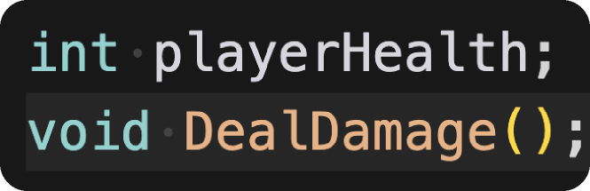
Easy to read > Naming
Notes:
or this?

Slide 7
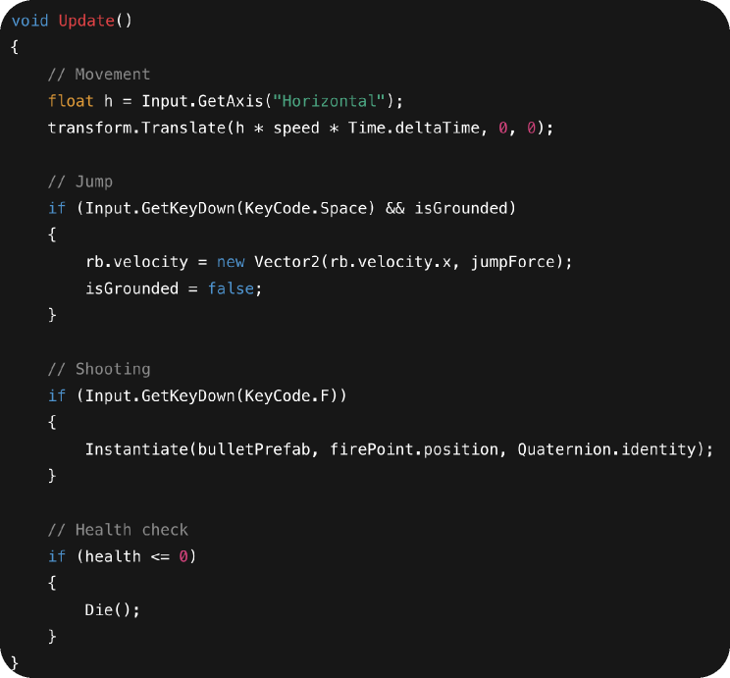
Easy to read > Small Functions
Notes:
what does this do?

Slide 8
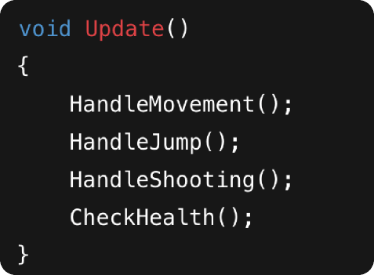
Easy to read > Small Functions
Notes:
this is a better solution

Slide 9
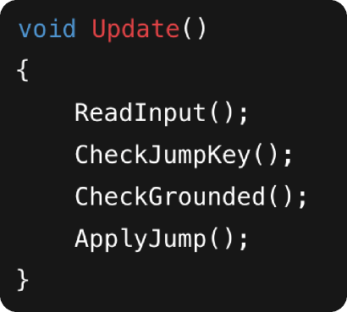
Easy to read > Small Functions
Notes:
too small is also bad

Slide 10
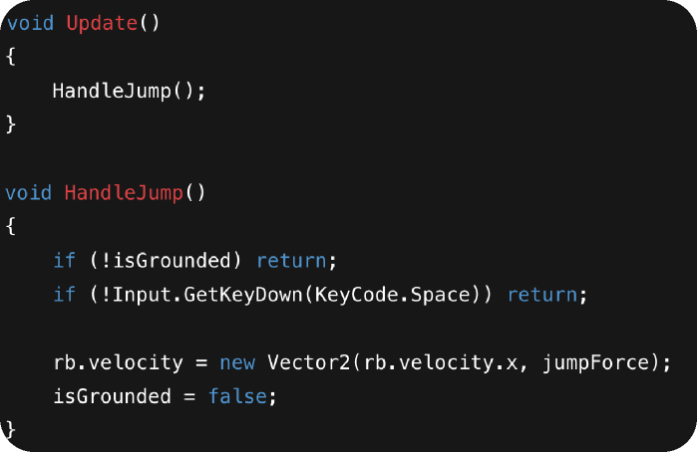
Easy to read > Small Functions
Notes:
balance

Slide 11
Rule One function = one job.
Notes:
If a function needs many comments, it’s probably doing too much.

Slide 12
Fault tolerant?
Notes:
what does easy to read mean?

Slide 13
Fault tolerant > Null
What is a potential problem here?

Slide 14
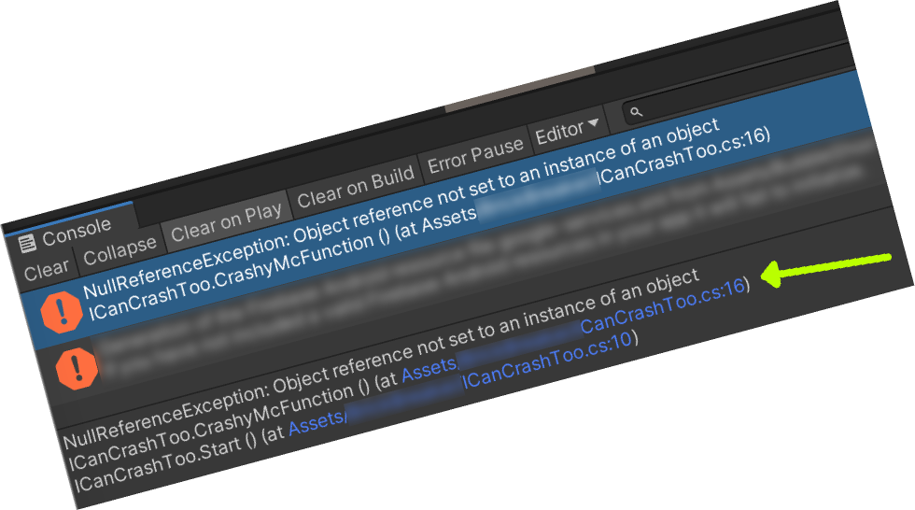
Fault tolerant > Null
What is a potential problem here?
Notes:
player is null
Most runtime crashes in Unity are null reference errors.

Slide 15
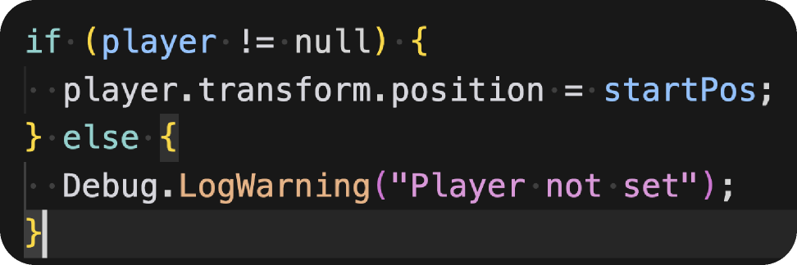
Fault tolerant > Null
A better solution..

Slide 16
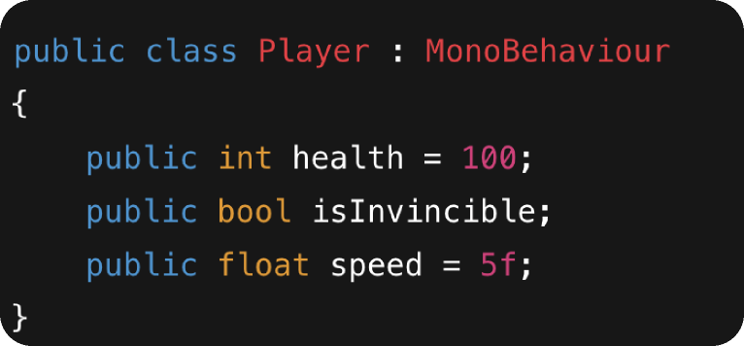
Fault tolerant > Private

Slide 17
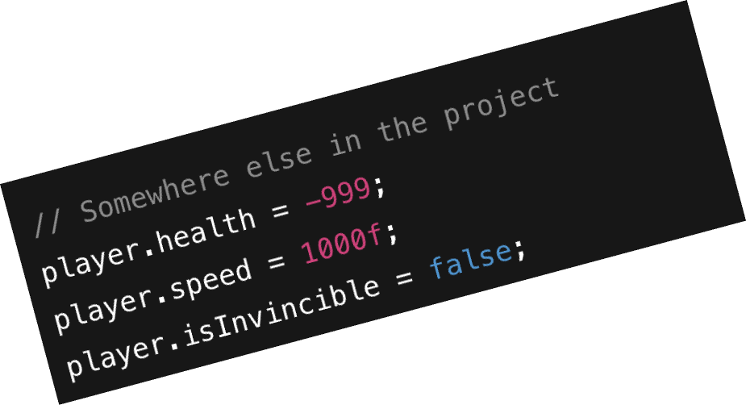
Fault tolerant > Private

Slide 18
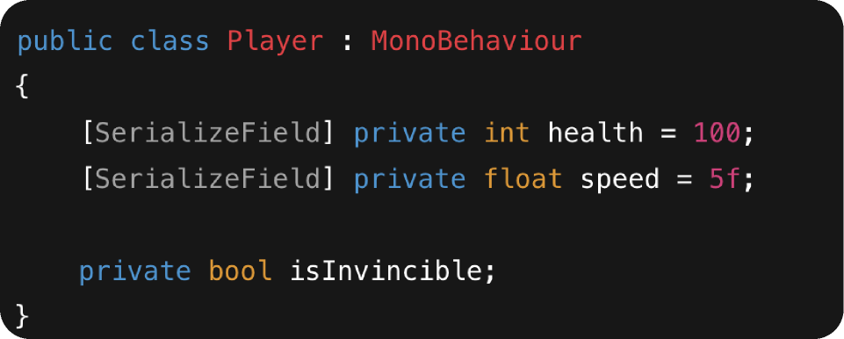
Fault tolerant > Private
A better solution..

Slide 19
Rule make variables private by default.

Slide 20
Effecient code?
Notes:
what does easy to read mean?

Slide 21
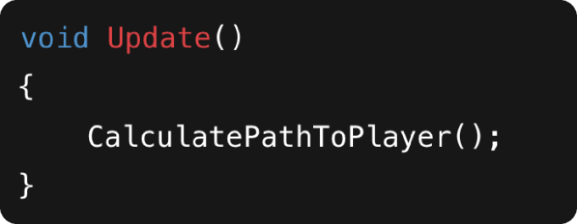
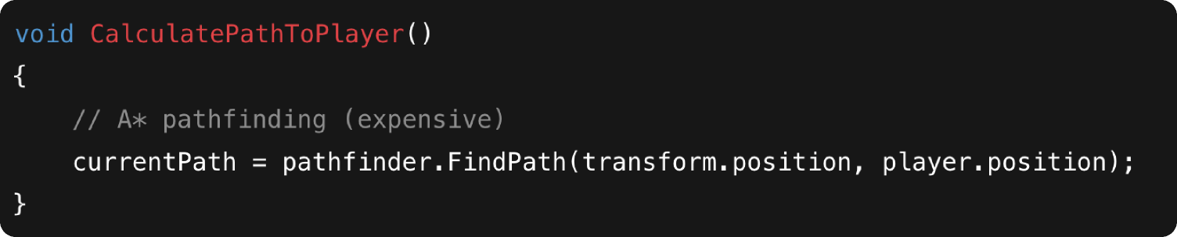
Efficient Code > Game Loop
Too costly..

Slide 22
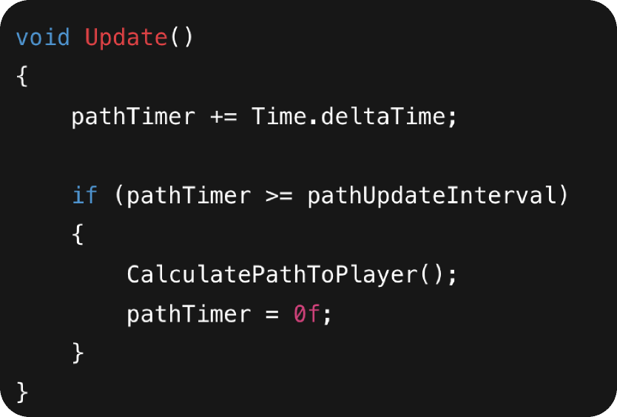
Efficient Code > Game Loop
A Much better solution

Slide 23
Efficient Code > Cache References

Slide 24
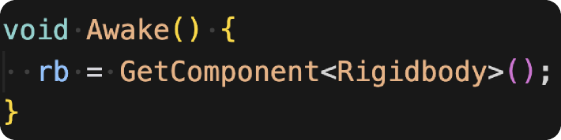
Efficient Code > Cache References
Notes:
Result
Same behavior
Better performance
Instructor notes
Unity lookups are not free. Cache once, reuse forever.

Slide 25
Designer Friendly?
Notes:
what does easy to read mean?

Slide 26
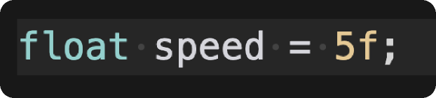
Designer-Friendly Code > Expose Variables
Notes:
Result
Same behavior
Better performance
Instructor notes
Unity lookups are not free. Cache once, reuse forever.

Slide 27
Designer-Friendly Code > Expose Variables
Show it in the inspector.
Notes:
Result
Same behavior
Better performance
Instructor notes
Unity lookups are not free. Cache once, reuse forever.

Slide 28
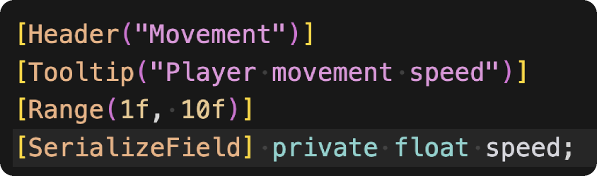
Designer-Friendly Code > Expose Variables
Or Much better..
Notes:
Result
Same behavior
Better performance
Instructor notes
Unity lookups are not free. Cache once, reuse forever.

Slide 29
Rule
Designers can change behavior without touching code.
Unless you want more meetings, Slack messages, and frustration.
Notes:
This reduces

Slide 30
Code is for humans first
Designers are users too
Bugs are inevitable — crashes aren’t
Performance is a design choice
In short ..

Slide 31

Game Programming, KFUPM
By Dr. Omar Hammad
join the discussion
discord.gg/jSyF3RJS
Thank you

